Slide 1
Renal Optimization Strategies
Evaluation in Acute Heart Failure (ROSE AHF):
A Randomized Clinical Trial
Horng H Chen MD
on behalf of the
NHLBI Heart Failure Clinical Research Network

Slide 2
Background
AHF + Renal Dysfunction
Patients with acute heart failure (AHF) and renal dysfunction are at risk for inadequate decongestion and worsening renal function – factors associated with adverse clinical outcomes.

Slide 3
Background
Low dose dopamine
Low or “renal” dose dopamine may selectively activate dopamine receptors and promote renal vasodilatation.
Previous small studies suggest that low dose dopamine (2-5 μg/kg/min) may enhance decongestion and preserve renal function during diuretic therapy in AHF.

Slide 4
Background
Low dose nesiritide
Nesiritide at recommended dose (2 μg/kg bolus + 0.01 μg/kg/min infusion) lowers blood pressure and does not favorably impact renal function or clinical outcomes.
Previous small studies suggest that low dose nesiritide (0.005 μg/kg/min without bolus) may have renal specific actions which enhance decongestion and preserve renal function during diuretic therapy in AHF.

Slide 5
Hypotheses
Novel study design
In patients with AHF and renal dysfunction:
I. As compared to placebo, the addition of low dose dopamine (2 μg/kg/min) to diuretic therapy will enhance decongestion and preserve renal function
II. As compared to placebo, the addition of low dose nesiritide (0.005 μg/kg/min without bolus) to diuretic therapy will enhance decongestion and preserve renal function.

Slide 6
Study Population
Diagnosis of AHF:
  ≥1 symptom (dyspnea, orthopnea, edema)
  ≥ 1 sign (rales, edema, ascites, CXR)
Enrolled within 24 hours of hospital admission
Estimated GFR of 15 - 60 mL/min/1.73m²
  Modification of diet in renal disease equation

Slide 7
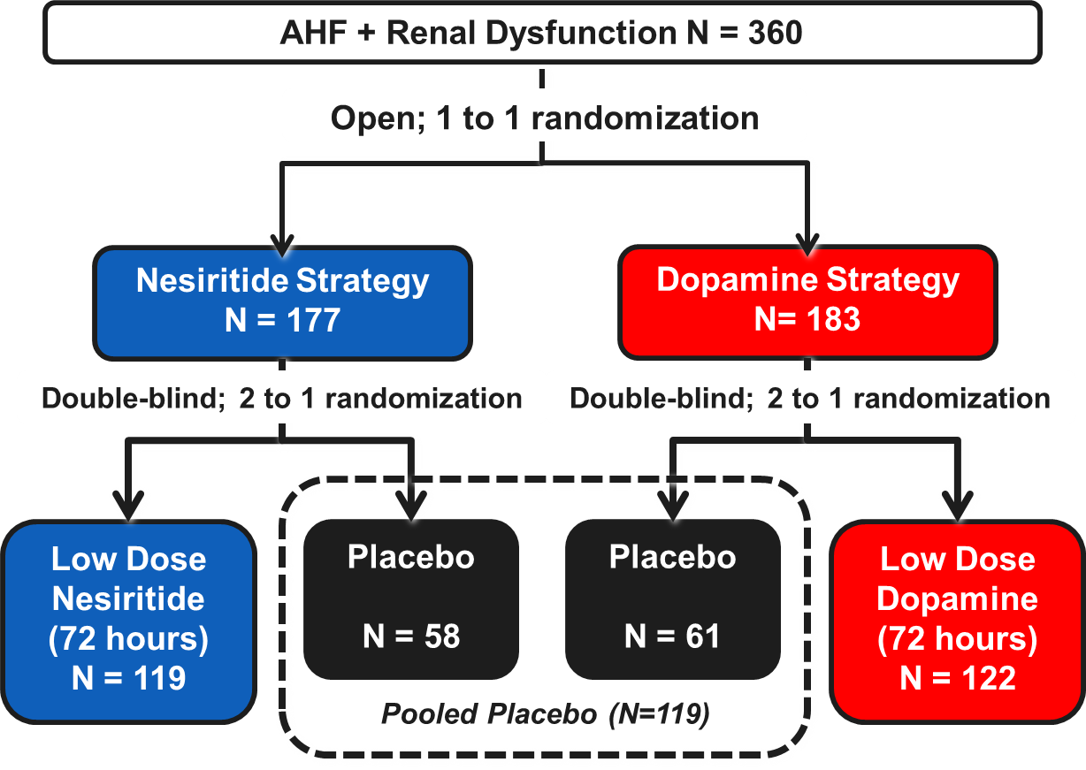
Study Design
Standardized Diuretic Dosing For 1st 24 hours
2.5 x Outpt Furosemide Equivalent in Divided (BID) IV Doses

Slide 8
Co-Primary Endpoints
Decongestion Endpoint: Cumulative urinary volume from randomization through 72 hours
Renal Function Endpoint : Change in serum cystatin-C from randomization to 72 hours

Slide 9
Secondary Endpoints
Decongestion endpoints
  Change in weight: randomization to 72 hrs,
  Change in NT-proBNP: randomization to 72 hrs
Renal function endpoints
  Change in creatinine: randomization to 72 hrs,
  Cardio-renal syndrome (↑Cr > 0.3 mg/dL)
Symptom relief endpoints
  Dyspnea VAS; AUC over 72 hrs
Clinical endpoints
  Drug tolerance
  Adverse events

Slide 10
Statistical Methods
> 85% power to detect effect (p<0.025) of
  72 urine volume of > 1400 ml
  Change in cystatin C of > 0.3 mg/L
Treatment comparisons by “intention to treat”
Multiple imputation for missing data.
Conservative framework for subgroup interaction testing (interaction p-value <0.01)

Slide 11
Baseline Characteristics
Characteristic | All patients (n=360)
Age (years) | 70
Male | 73%
AHF hsp in past year | 67%
Ischemic etiology | 58%
Diabetes | 56%
EF > 50% | 26%
Median or % shown; No significant between group differences

Slide 12
Baseline Characteristics
Characteristic | All patients (n=360)
Outpt Furosemide Dose (mg) | 80
ACE inhibitor or ARB | 50%
Beta-blocker | 83%
Systolic BP (mmHg) | 114
eGFR (ml/min/1.73m²) | 44.5
NT-proBNP (pg/ml) | 4972
Median or % shown; No significant between group differences
Notes:
Took out BMI and aldo antag

Slide 13
Results
Dopamine Strategy

Slide 14
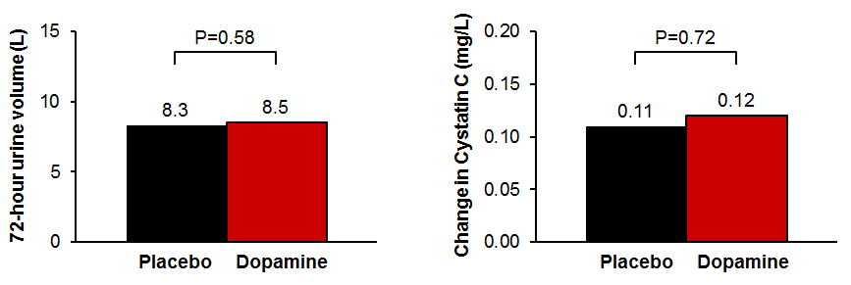
Low Dose Dopamine:
Co-primary End-points
72 Hour Urine Volume
Change in Cystatin-C

Slide 15
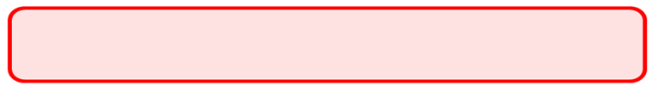
Low Dose Dopamine
Sub-group Analysis

Slide 16
Low Dose Dopamine
Secondary Endpoints
No significant treatment effect on secondary endpoints reflective of:
  Decongestion
  Renal function
  Symptom relief
Study Drug Tolerance | Dopamine (n=122) | Placebo (N = 119) | P Value
Study drug reduced dose or d/c - Hypotension | 0.9% | 10.4% | <0.001
Study drug reduced dose or d/c - Tachycardia | 7.2% | 0.9% | <0.001
Study drug d/c before 72 hrs – Any Cause | 23% | 25% | 0.72

Slide 17
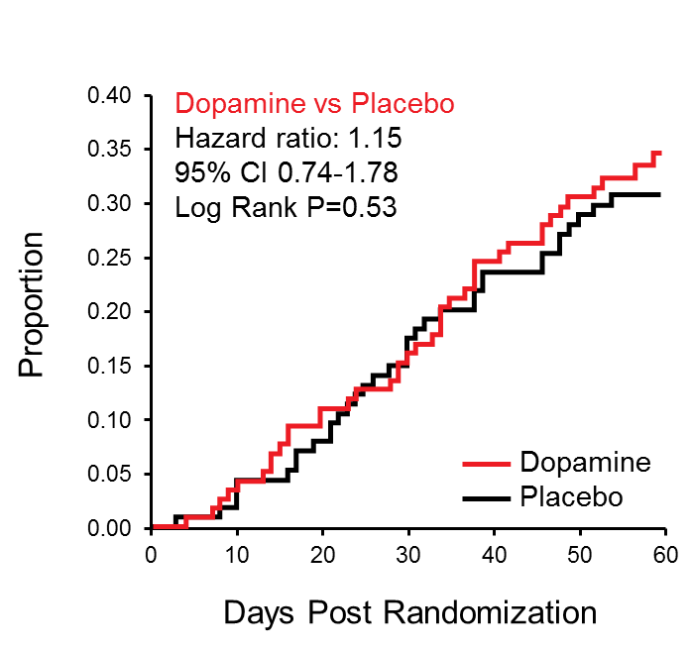
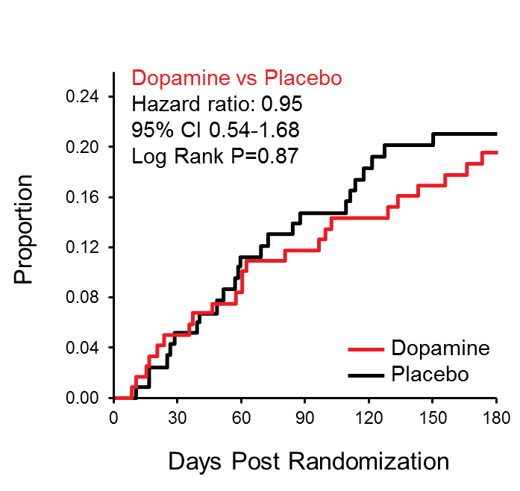
Low Dose Dopamine
Clinical Outcomes
60 Day Death/ Unscheduled office visit/ HF Readmission
180 Day Mortality

Slide 18
Results
Nesiritide Strategy

Slide 19
Low Dose Nesiritide
Co-primary End-points
72 Hour Urine Volume
Change in Cystatin-C

Slide 20
Low Dose Nesiritide
Sub-group Analysis

Slide 21
Low Dose Nesiritide
Secondary Endpoints
No significant treatment effect on secondary endpoints reflective of:
  Decongestion
  Renal function
  Symptom relief
Study Drug Tolerance | Nesiritide (n=119) | Placebo (N = 119) | P Value
Study drug dose reduced or d/c - Hypotension | 18.8% | 10.4% | 0.07
Study drug dose reduced or d/c - Tachycardia | 0% | 0.9% | 0.50
Study drug d/c before 72 hrs – Any Cause | 25% | 25% | 0.94

Slide 22
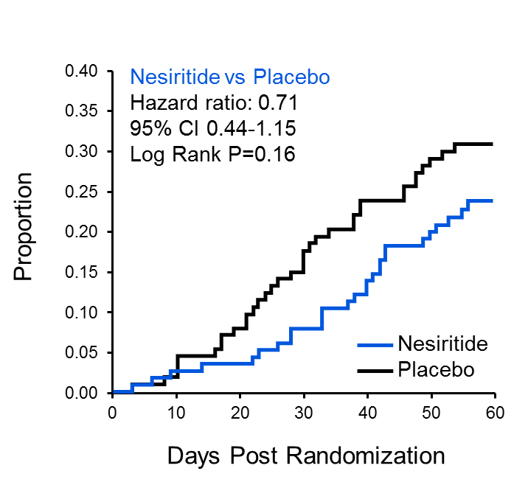
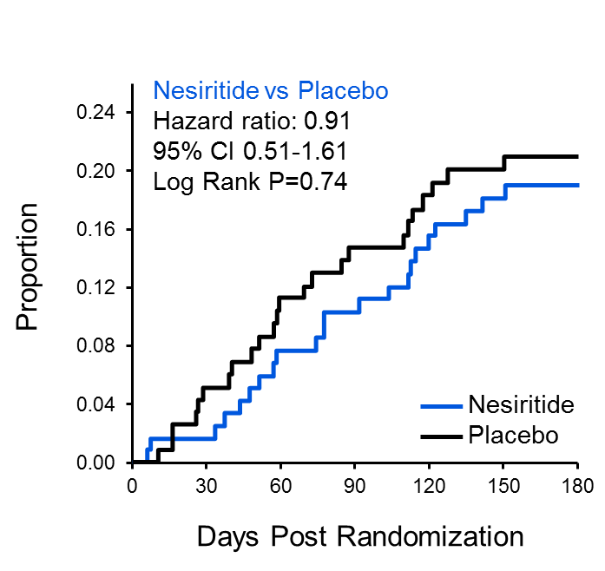
Low Dose Nesiritide
Clinical Outcomes
60 Day Death/ Unscheduled office visit/ HF Readmission
180 Day Mortality

Slide 23
Conclusions
In patients with AHF and underlying renal dysfunction, when added to standardized diuretic dosing, neither low dose dopamine, nor low dose nesiritide, enhanced decongestion or improved renal function.
Future investigations of these or other acute heart failure therapies may need to assess the potential for differential responses in heart failure and preserved versus reduced ejection.

Slide 24

Montreal Heart Institute
Minnesota Heart Failure Consortium
University of Vermont/
Tufts University
Mayo Clinic
Harvard University
University of Utah
Cleveland
U. Pennsylvania
Thomas Jefferson University
NHLBI
Washington University
DCRI
Duke University
Emory University
Morehouse School of Medicine
Baylor College of Medicine

Slide 25
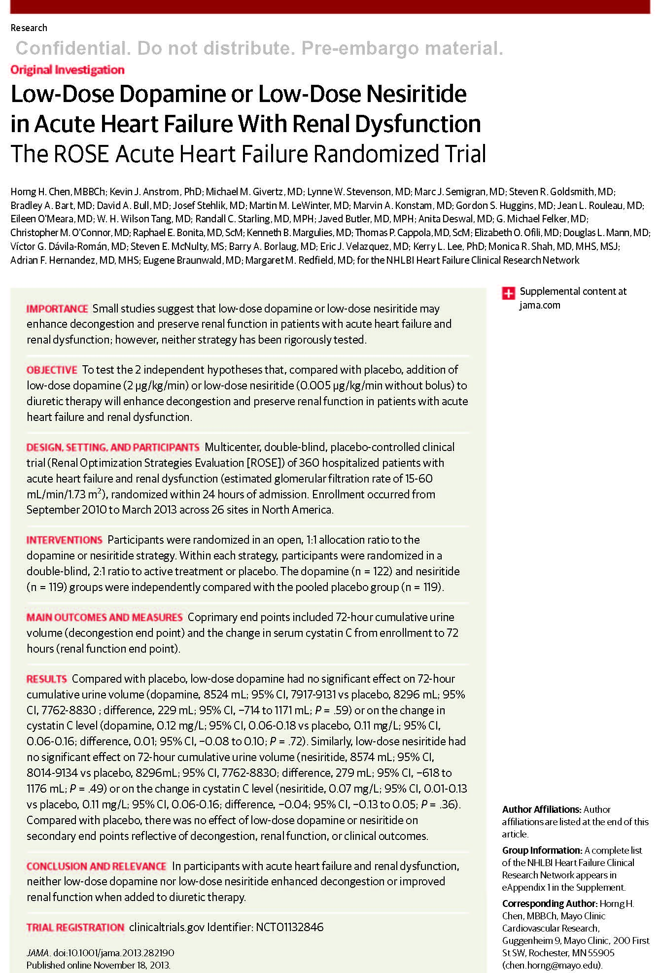
HH Chen and coauthors
Low-Dose Dopamine or Low-Dose Nesiritide in Acute Heart Failure With Renal Dysfunction: The ROSE Acute Heart Failure Randomized Trial
Published online November 18, 2013

